Slide 1
TEAM
STUDIO 71

Slide 2
Team Leader
Ahmed Swaroar Arnob
B.Sc(Engg) , ME
Khulna University of Technology
M.Sc , Computer Science
Jahangirnagar University (Ongoing)
Team Member 1
Ahmed Safayet Amio
B.Sc , Leather Engineering
2nd Year
Dhaka University
Team Member 2
Oitijya Islam Auvro
B.Sc(Engg) , CSE
Khulna University of Technology
3rd Year (Ongoing)

Slide 3
VISION
We , studio 71 , believe that making a change in core mindset and way of thinking of people in our country could be changed .
If we can convey messages and educate them in an entertaining way.
So, we want to Create impact on “Game Dev” industry by creating meaningful story-based games.

Slide 4

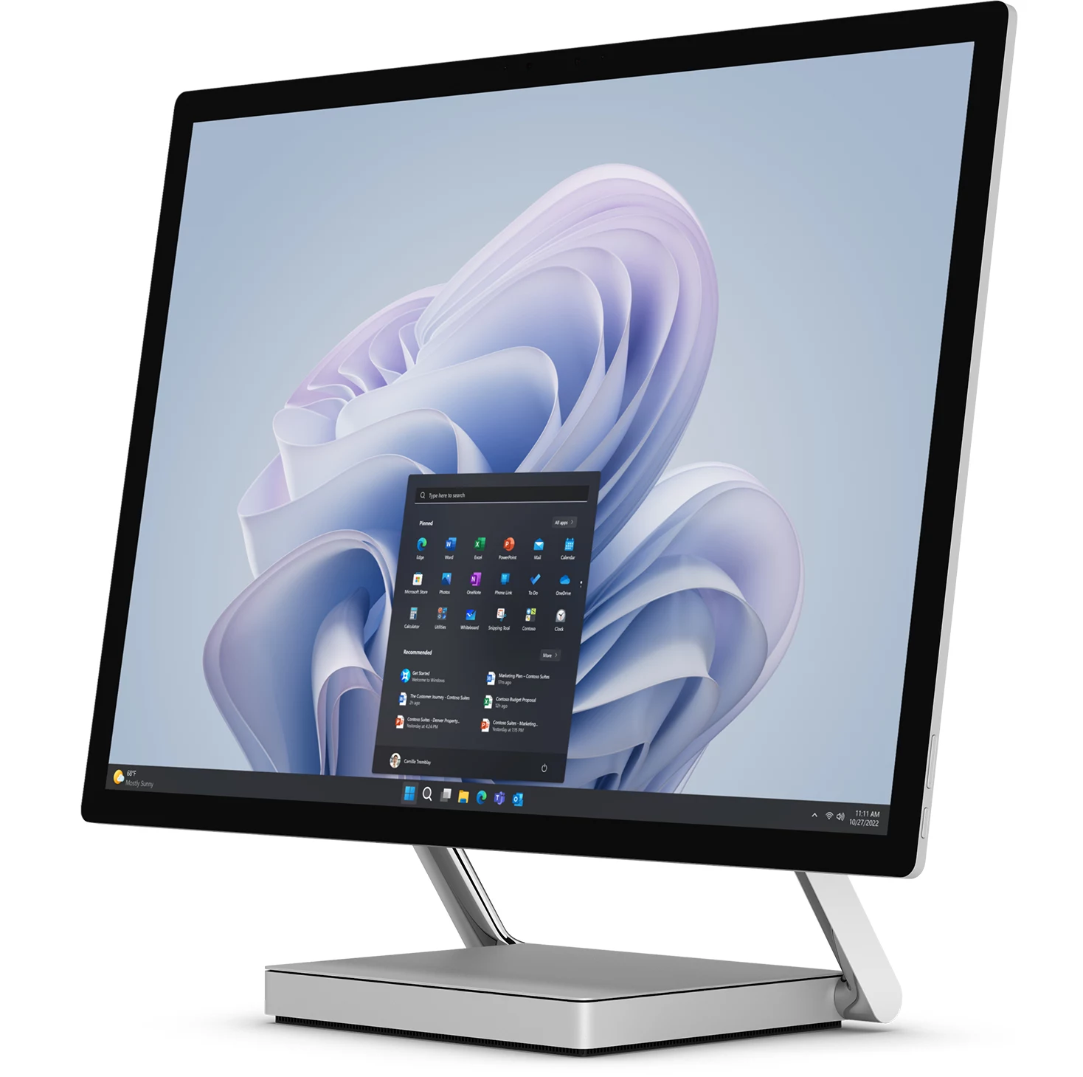
Target Platform
Our primary target is windows pc.
Then we are opting for Android mobile,
considering huge market in BD.

Slide 5
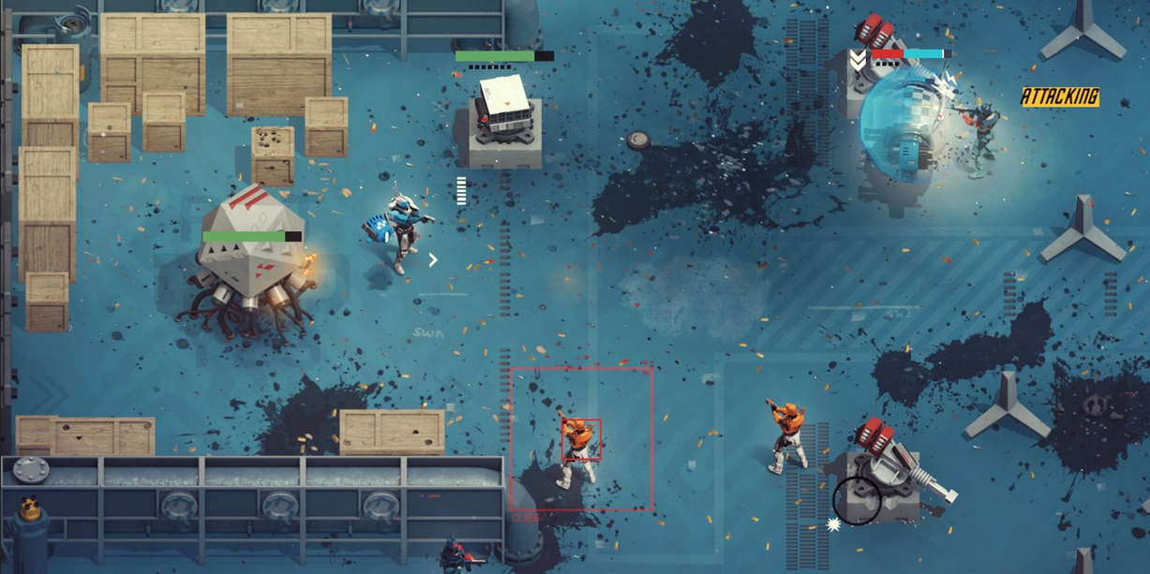
Gameplay Experience & Genre
We are initially opting for a top-down shooting game with a high focus on strategy making .
Control should done by keyboard and mouse for PC version.

Slide 6

Audience
Our main target audience is our dear
revolutionary Gen-Z.
It is important to educate them and convey the true history of Liberation war 71

Slide 7
Key Features of Design and Mechanics
Single player with selectable multiple class system.
Single type control, rest are operated by AI.
AI Bot targets different classes.
Attack and Defense type level.
Obstacle mechanism, 3 state AI system
Player movement: keyboard & mouse.
Low – poly level design

Slide 8
Project Timeline
Tasks | Week1 | Week 2 | Week 3 | Week 4 | Week 5 | Week 6 | Week 7 | Week 8 | Week 9 | Week 10
Planning & Setup
Core Mechanics Development
Game Systems
Level Design & Assets
Polish & Audio
Final Testing & Release

Slide 9
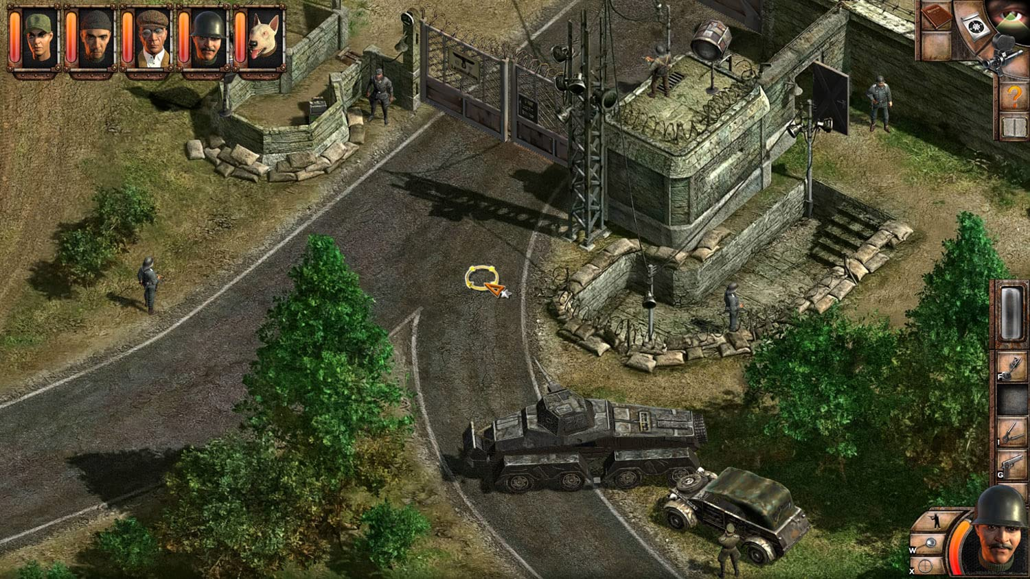

Game Reference

Slide 10
THANK YOU
Long live BD

